Slide 1
Chapter 31 DC Circuits

Slide 2




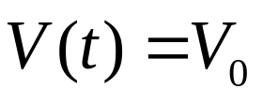

The direction of current is the direction of positive charge would move.
Battery
Resistor
Current
Current
Direct Circuits (DC)
Circuits
Alternating Circuits (AC)

Slide 3
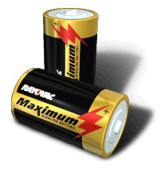
The direction of current is the direction of positive charge would move.
Battery
Resistor
Current
Current
i
A “pump” for charge, maintains the constant potential difference between its two terminals. A source of energy to raise the energy of electrons.
pump for charge

Slide 4
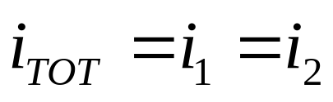
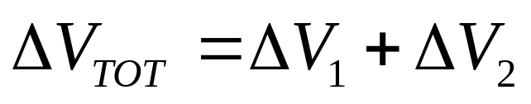
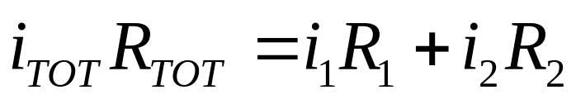
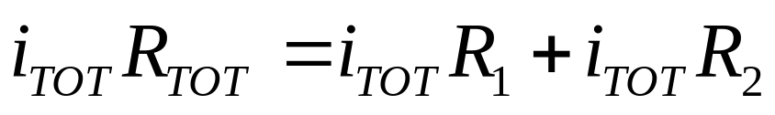
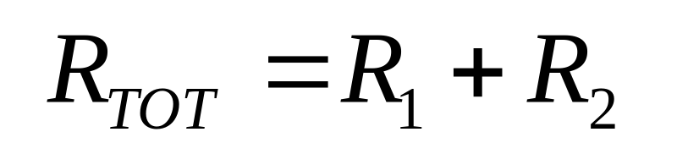
Resistors in Series and Parallel
Combining Resistors in series
i_{TOT}
Current is not used up
R₁
ΔV₁
i₁
ΔV_{TOT}
R₂
ΔV₂
i₂
Resistors in series add.
i_{TOT}

Slide 5
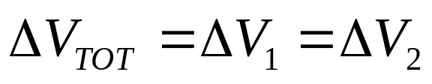
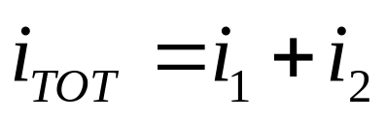
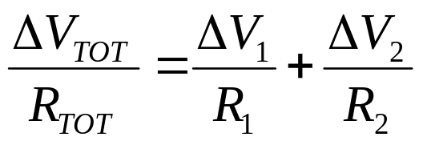
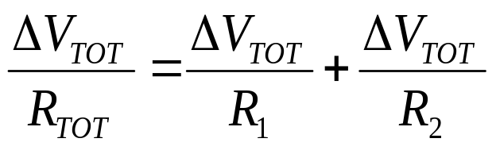
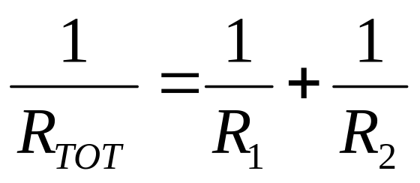
Combining Resistors in parallel
i_{TOT}
i₂
Key point
ΔV_{TOT}
R₁
ΔV₁
R₂
ΔV₂
i₁
i₂
Resistors in parallel add as reciprocals

Slide 6
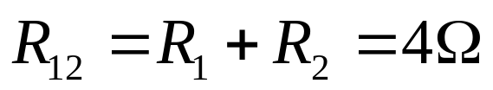

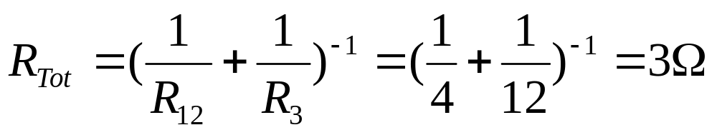
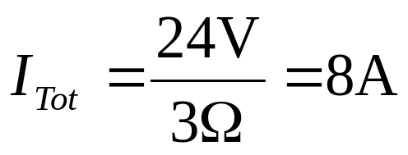
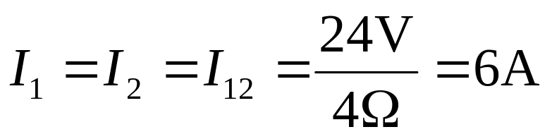
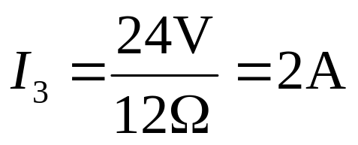
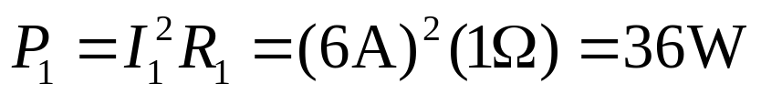
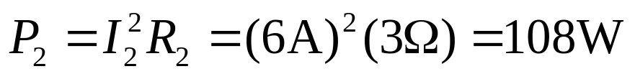
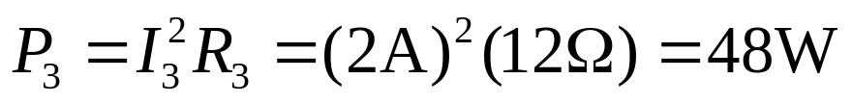
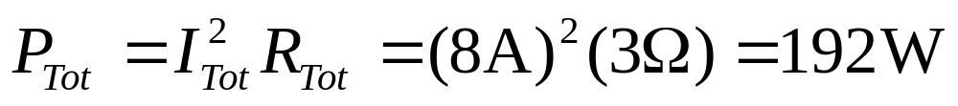
Example: Find the currents and power loss for each resistor.
R₂=3Ω
B
A
R₁=1Ω
R₃=12Ω

Slide 7
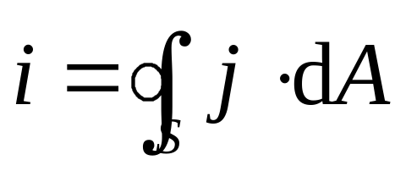
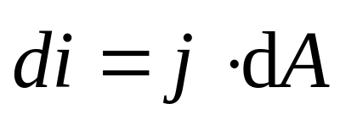
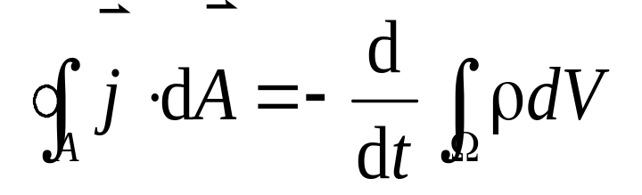
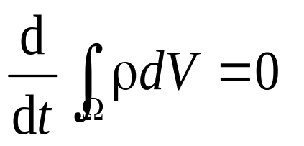
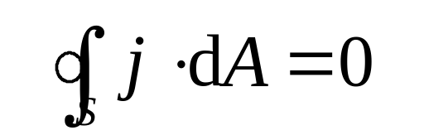
Conservation of Charge
Consider the flux of current density through a closed surface,
j
j
Therefore the law of charge conservation is expressed as:
For a steady current (e.g., the current in DC circuit),

Slide 8
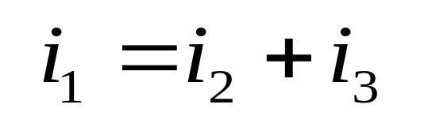
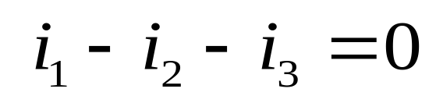
Conservation of Charge
Consider the flux of current density through a closed surface,
Consequently, at any junction in an electric circuit,
j
j
i₂
A₁
A₂
i₁
i₃
A₃
the total current entering the junction must be equal to the total current leaving the junction.

Slide 9
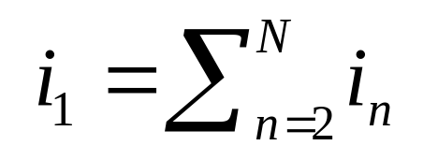
i₂
In general,
i₃
i₁
i_{N}
This is called junction rule (Kirchhoff’s first law).

Slide 10
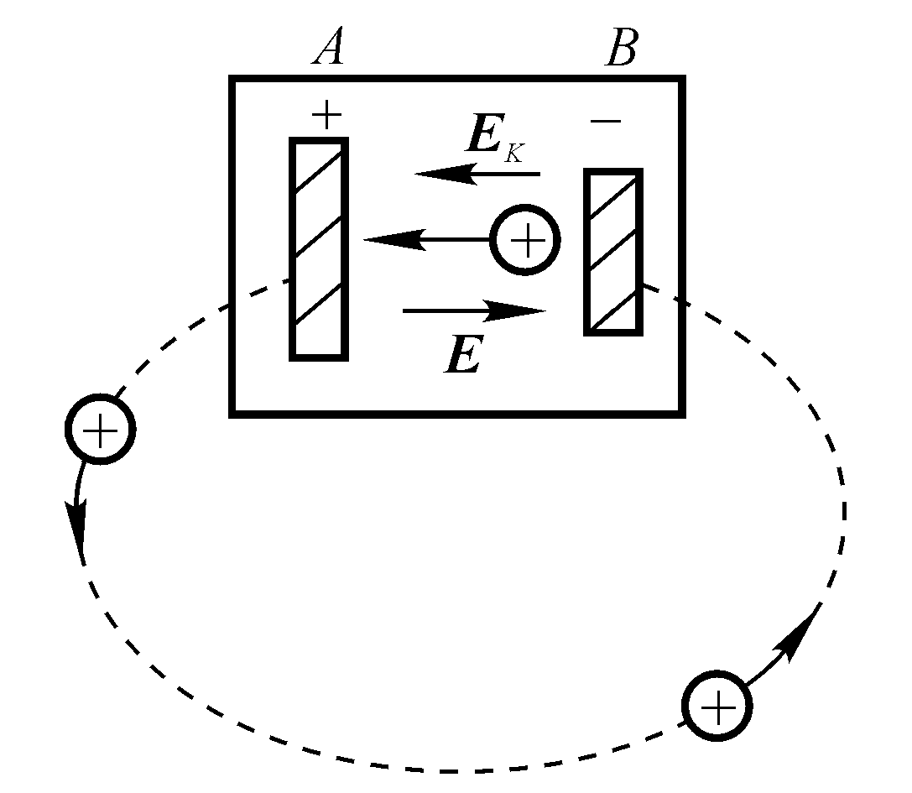
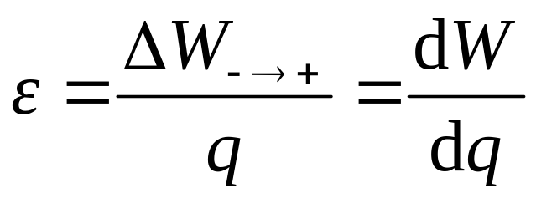
Electromotive Force(EMF)
  A device that maintains a constant potential difference between two points in the circuit.
  Does this by moving charges from low to high potential by doing work.
The EMF ε of a source is defined as the work on per unit positive charge,
The EMF is a device transferring from variety of energy to electric energy.
  Battery : Uses chemical energy to do work
+
  Generator : Uses mechanical energy to do work
-
  Solar Cell : Uses light to do work
Joule/Coulomb = Volt

Slide 11
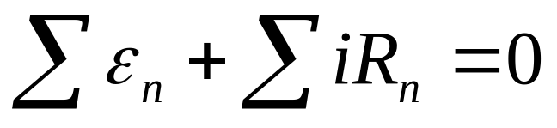
Method of potential differences : differences in potential across each circuit element.
Making a complete loop gives total ΔV =0 !!!
Analysis of Circuits
This is called loop rule (Kiechhoff’s second law)
i
V_{High}
ε
+
Guess a direction for the current first.
-
V_{Low}
Passing through a resistor in direction of current
flow, from a high potential to a low potential gives
ΔV = V_{final} - V_{initial} = V_{low} - V_{high} = - iR (<0)
Passing through battery from “- ” to “+” , the potential increases so ΔV = V_{high} - V_{low}= ε (>0)

Slide 12
It can be used the following two rules:
1. Junction Rule
At any junction in an electric circuit, the total current entering the junction must be the same as the total current leaving the junction.
2. Loop Rule
The algebraic sum of all differences in potential around a complete circuit loop must be zero.
What is “±” for the differences potential of resistor?
What is “±” for the differences potential of EMF?

Slide 13
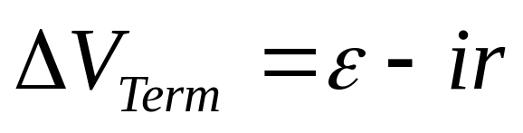
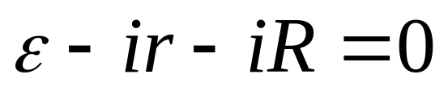
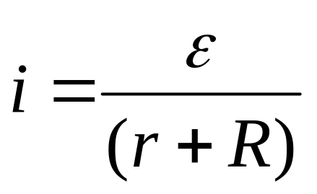
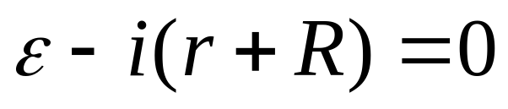
Analysis of Circuits
i
r
ε
+
ε
R
-
Real batteries have internal resistance. So what does our circuit really look like?

Slide 14
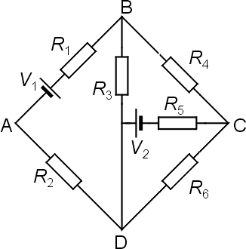
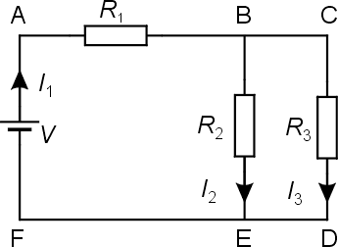
Multi-loop DC Circuits
Examples:
It can be reduced to a simple one-loop circuit.

Slide 15
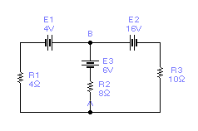
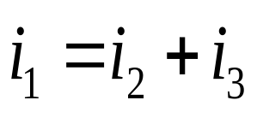
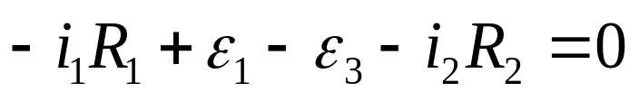
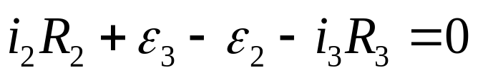

Example
Find i₁, i₂, i_{3.}
i₁
The junction rule at junction B gives:
i₃
i₂
The loop rule leads to:
  There is another loop (around outside) but it gives no
  new information, just the sum of the equations above:

Slide 16
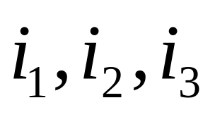
Example
Find i₁, i₂, i_{3.}
i₁
The junction rule at junction B gives:
i₃
i₂
The loop rule leads to:

Slide 17



Example
Find i₁, i₂, i_{3.}
i₁
The junction rule at junction B gives:
i₃
i₂
The loop rule leads to:
This means those two currents are flowing opposite to the directions assumed
Note that i₁ and i₃ turned out negative!

Slide 18
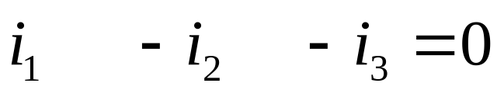
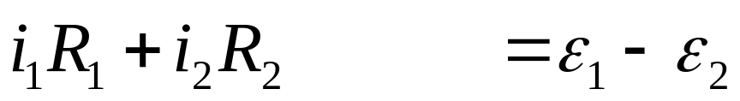
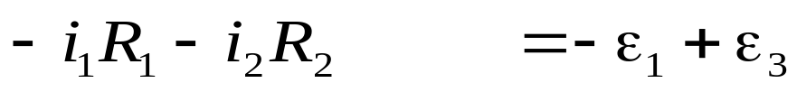
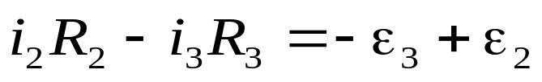
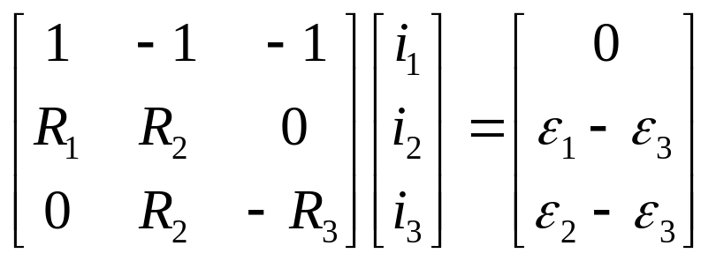

Example
Find i₁, i₂, i_{3.}
i₁
The junction rule at junction B gives:
i₃
i₂
Matrix method
I=VR⁻¹
RI=V

Slide 19
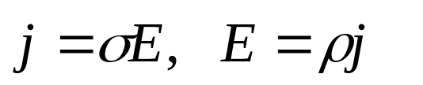
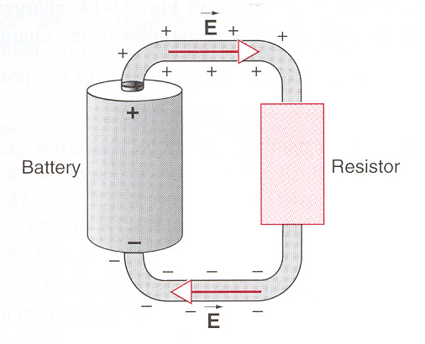
Electric Fields in Circuits
In a conductor,
Where does the electric field in wires come from?
A tiny amounts of charge on the surface of wires provide the electric field

Slide 20










Energy Transfers in an Electric Circuit
As the battery moves a quantity of charge dq from its negative terminal to its positive terminal, it does work
The potential difference between two terminals of the resistor is,
i
As a dq moves through the resistor, it experiences a potential energy change:
The power delivered by the source of EMF (battery) is then:
This energy must be transferred to the resistor, known as Joule Heating.
The power transferred to the resistor reads:

Slide 21




In a real battery with internal resistance r, the potential difference between the terminals is,
The charge dq passing through the battery gains potential energy :
The power delivered by this battery is:

Slide 22

















RC Circuits
Combine Resistor and Capacitor in Series
  At t = 0, q(0) = 0
  At t=τ, q(τ) = 0.63Cε
  At t = ∞, q(∞) = Cε
  At t = 0, i(0) = ε/R
  At t=τ, i(τ) = 0. 37ε/R
  At t = ∞, i(∞) = 0
a
  At t = 0, V_{c}(0) = 0
  At t=τ, V_{c}(τ) = 0.63ε
  At t = ∞, V_{c}(∞) = ε
  Switch at position (a) V_{C}(t)=?
ε
b
R
C

Slide 23










  Then switch turn to b, C discharges:
a
ε
b
R
C

Slide 24














Example
Time to charge capacitor
a
How long time dose voltage of C to ε/2 ?
ε
R
b
12Ω
1μF
C
Voltage on capacitor:

Slide 25




Example
a
How long time dose voltage of C reduce to ε/2 ?
ε
R
b
12Ω
1μF
C
Voltage on capacitor:

Slide 26








Example
a
How long time dose voltage of C reduce to ε/2 ?
ε
R
b
12Ω
1μF
C

Slide 27








Example
Energy?
a
ε
R
b
12Ω
1μF
C

Slide 28












Example

Slide 29
Exercises
P719~722 11, 13, 25, 47
Problems
P724 15

Slide 30






Example

Slide 31

Example

Slide 32


Example

Slide 33




Example

Slide 34



Example

